Slide 1
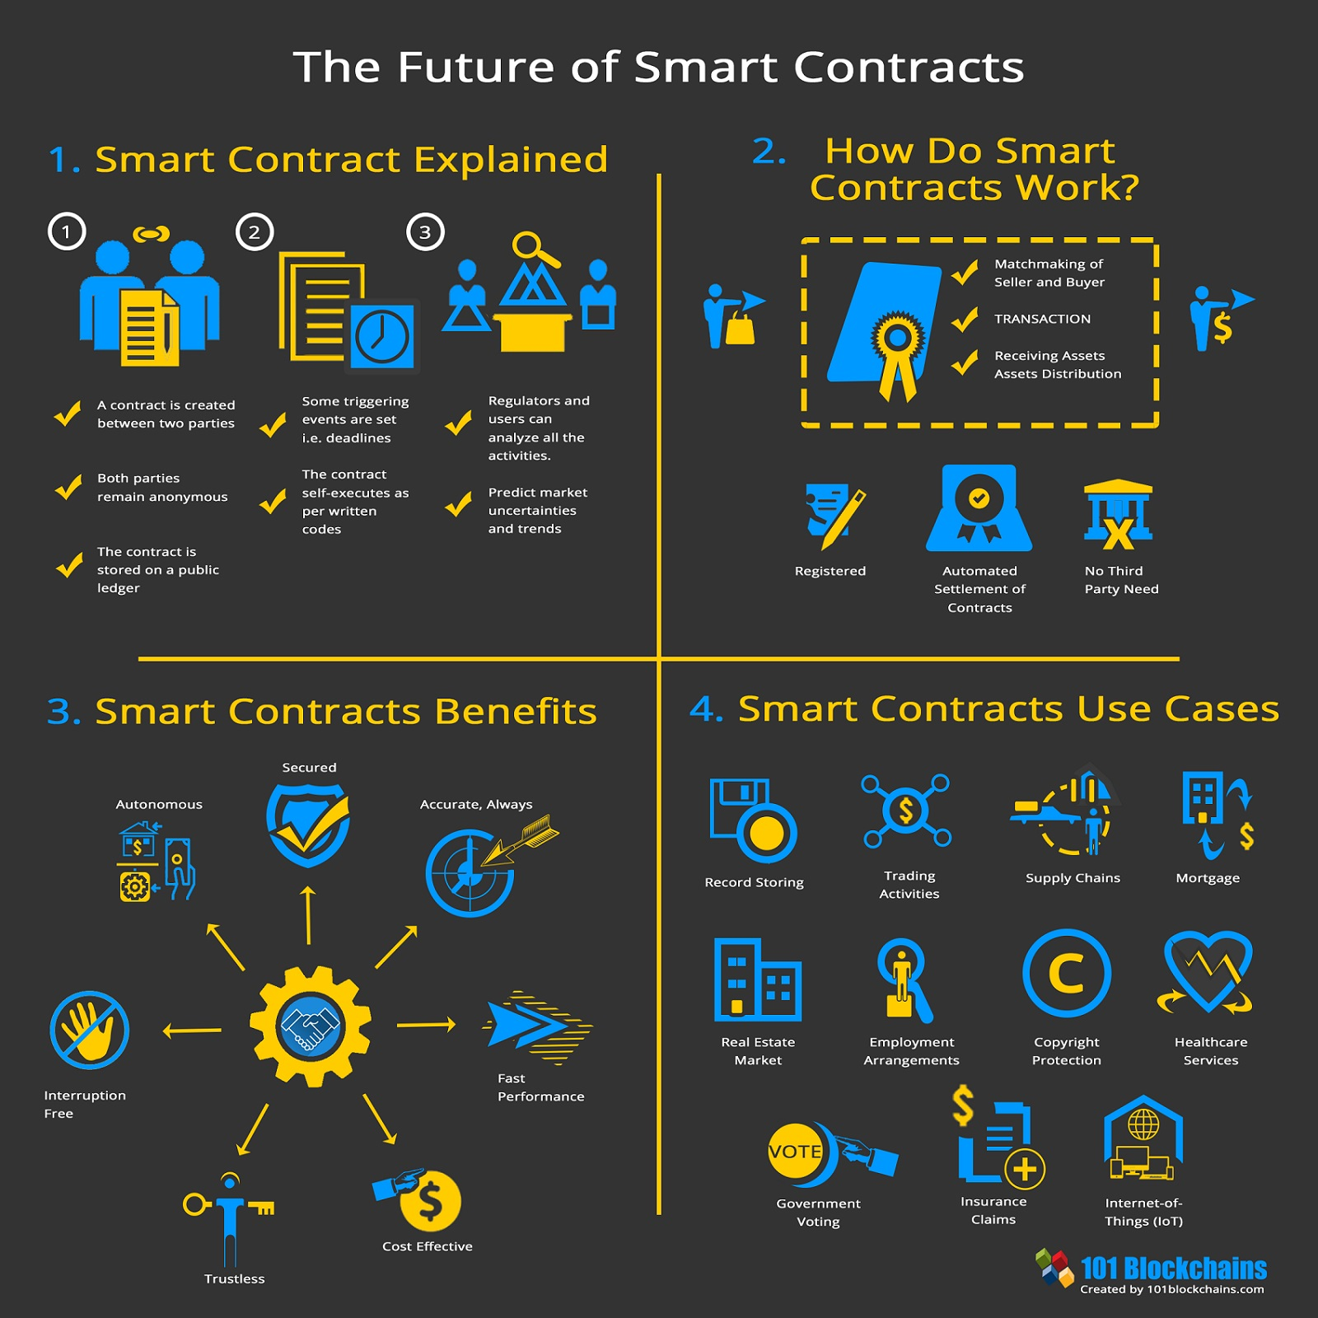
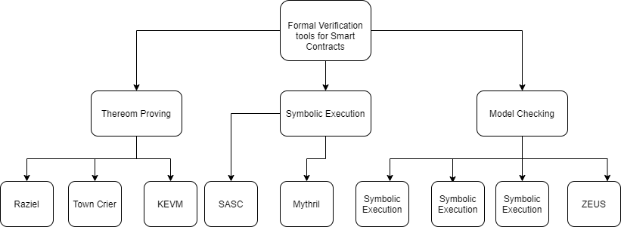
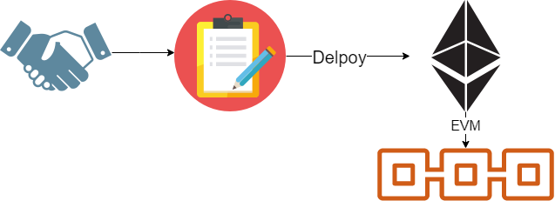
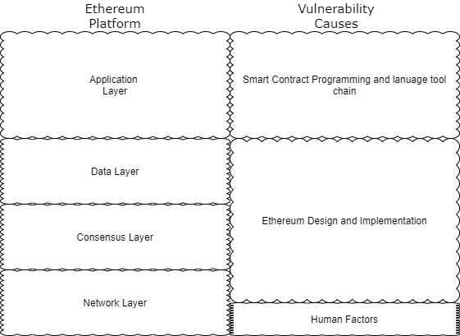
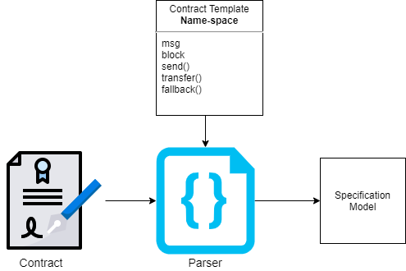
Formal Verification of Smart Contract
Omar Jarkas, Naipeng Dong, & Guangdong Bai
Background
The introduction of Smart Contracts is paving the way for a new paradigm of financial arrangements and interactions.
With the security, immutability, and decentralization characteristics of the Ethereum platform, Smart Contracts are changing the way deals are made.
Those same characteristics bode some serious restrictions when developing such contracts.
Due to the immutable coupling of contract code with financial values, code written should always be of ultimate efficiency, security, and correctness.
Formal Verification has emerged as the prominent method for testing the correctness of contracts before deploying them to the chain.
Finding the right mix between the formal methods, design patterns, and testing trade-offs are often challenging and require extra implementation.
This paper introduces a parser and a specification model that implements Smart Contract formal verification modeling in the Dafny Language
Smart Contracts
In 2014, the Ethereum platform along with its virtual machine emerged. Ethereum came to solve many problems faced in Bitcoin that made it limited in potential and support Smart Contracts. Smart Contracts are nothing but computer programs deployed on the blockchain and executed by the virtual machine. Such applications can facilitate the smooth collaboration between separate organizations and independent parties. They are called contracts due to the blockchain’s ability to guarantee enforceability of specific predefined condition and agreement mimicking real-world contracts.
Related Work
Pegasus Team is ConsenSys using Dafny to formal verification Ethereum 2.0 Specs
Using Dafny To Formally verify Proof of Stake Consensus algorithm
Using F* to Formal Verify Smart Contracts
Using Isabelle/HOL to Formal Verify Smart Contracts on the Bytecode
Surveying Smart Contract Security Patterns and Vulnerabilities
Survey of Formal Verification tools and techniques used on Smart Contracts
Framework and Parser
In this project, we introduce a formal template and parser to implement a formal verification model using the Dafny Language. The Template is built on the work of a GitHub Repository to try to implement a specification model in Dafny for Ethereum Smart Contracts. The Specification model is in the context of the global namespace of the Solidity language that enables it to interact with other contracts, users, and the blockchain environment.
Tools used
Formal Verification
Specification can be extremely hard to model accurately due to the generality of the system, hence, finding an adequate design formalization technique can also be difficult.

